Slide 1
Organizational Dynamics of Cisco Systems
Organizational Assessment Presentation
04/28/2018

Slide 2
Description of Cisco’s Systems
  Cisco systems is an American multinational technology corporation.
  It was founded in December 1984 by two Stanford University computer science students at the time.
  It’s headquarters are in San Jose, California at the heart of Silicon Valley.
  It is the largest networking company globally.
  The company focusses on developing, manufacturing and selling telecommunications equipment, network hardware among other high technology products and services.
  It specializes in specific markets like domain security, internet of things among others via the various subsidiaries that it has like jabber and jasper.
Notes:
Cisco Systems Inc. is the largest networking company globally and was the most valuable company globally in 2000, with a $500 billion market capitalization (Kahler, 2015). There was an addition of its stock on June 8, 2009, to the Dow Jones Industrial Average. Additionally, it is also included in the S & P 500 index, the Russell 1000 index, NASDAQ-100 index as well as the 1000 Growth Stock Index.
The computer science university students who founded the company include Sandy Lerner and Leonard Bosack. The two initiated the Local Area Network (LAN) concept, which is being used for connecting geographically different computers over a multiprotocol router system.

Slide 3
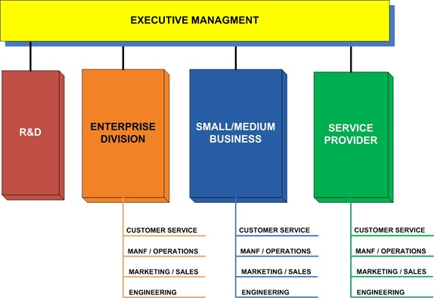
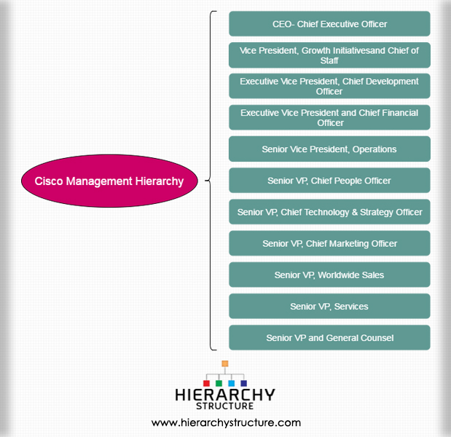
Analysis and Evaluation of Cisco’s Structure
Cisco’s Structure and Effectiveness
Notes:
The management hierarchy structure at Cisco is similar to the mid-management and the entry-level position as it is in the top management. Therefore, the company has junior level managers, mid-level and the entry-level employees (Pearson, 2017). The structure in all the levels is similar to the one shown above.
The hierarchical structure at Cisco is very effective in that each level of the organization has its managers who solve the problems that arise. In cases where the issue cannot be resolved at the lower levels, it is escalated to the mid and top management. The junior and mid-level managers have been given some powers to make decisions on certain aspects of the significant decisions of the company are made by the top management.

Slide 4
Analysis of the External and Internal Drivers
Factors affecting Organizational change and its execution
  Internal Drivers
  The managers at Cisco are empowered through training and refresher courses. They have been given the powers to make decision and drive positive change.
  The managers and leaders are also tasked with empowering the junior employees and ensure they understand the company’s mission and vision.
  The Organizational structure and culture of Cisco, its systems and communication allows for change.
  External Drivers
  The company has been accepted globally in the market due to its inclusivity in recruitment, its CSR policy and its quality products and services.
  It is also known to be the best company globally, technologically, it uses the best technology and offers customer centric products and services
Notes:
The internal factors impacting change at Cisco include the structure of the organization, which is well organized to drive the change agenda (Ashkanasy et al., 2016). There are hierarchies which ensure that whenever there is a problem, it is solved faster and in the best interest of the customers, the employees, and the company. The managers and leaders are also key in driving change for the company, they are the best in the industry due to the competitive recruitment policy of the company, and that leads to excellent results.
The external factors affecting the company, include factors affecting the company from outside and include the customers, technology and the society at large. The company has a policy of customer's first approach where they take customers feedback seriously and act on it. Their products and services are customer-centric. It uses advanced technology which ensures the quality of its products is top notch (Ashkanasy et al., 2016).

Slide 5
Analysis of the Culture of the Organization
The impact of personality, attitude and employees behaviors on the culture of the organization
    Cisco’s culture is based on the principles of customer focus, innovation transparent communication, employee empowerment and integrity.
    The company has given its culture an innovative and futuristic approach with the customers being at the top of the priority list.
    Most of its success is attributed to its relationship with customers, with the company designing software and systems based on the customer’s needs.
    It has also developed a culture of employee involvement and empowerment.
    The company has empowered its employees and they can make decisions on their own as long as it is for the company’s benefit.
    Its employees feel valued and behave in a manner that is in accordance with the company’s culture. Therefore, the retention rate is very high
Notes:
According to the company CEO, its culture is driven by high integrity, and by giving back using the available resources for a positive global impact. Since the company was founded in 1984, it has designed and launched different customer-focused software's. Due to its culture of innovativeness, it has also designed various software's and servers that foster interactive relationships with its customers, partners, suppliers, and employees. Customer satisfaction is critical, and they ensure they get feedback from the customers to ensure there is an improvement.
Its culture of employee involvement and empowerment has made the employees feel valued, and its retention rates are very high. The employees are therefore encouraged to take care of the company's assets as if they were their own. They behave in a manner that is per the culture of the organization due to the training and refreshers that they go through (Besharov & Smith, 2014)

Slide 6
Analysis of how staff is recruited, selected and Retained
Recruitment
Cisco’s recruitment process is very competitive , and is also a reflective of its culture, it recruits the best talent and ensure it values and retains them.
It ensures diversity is observed during the recruitment process to increase innovation. It therefore recruits people from diverse backgrounds, experience, ethnicities, ability, gender and culture.
The firm has been working with organizations such as the Hispanic IT Executive Council and The Society of Women Engineers to hire the more underrepresented minorities and women
Selection
They then select the best talent in the pool of potential candidates and train them in matters the organizational culture and operations in the company.
Retention
Its rates of retention are high due to how they treat their employees. All the employees are valued and treated with utmost respect.
The employees innovative ideas are also welcomed and put into consideration.
Notes:
Cisco is a worldwide firm, which works with people from different backgrounds, cultures, ethnicities, genders, age, and abilities. Through that understanding and building on its cross-cultural competence, the company has been globally accepted since it understands how to work with people from different backgrounds. Additionally, its commitment to diversity and inclusivity in recruitment makes it a better competitor, and it gets many opportunities worldwide. The company also embraces the human network in all its multiplicity, and through that, it can foster innovation and talent in the workplace, which aids in better final products and services (Bolman & Deal, 2017) .
Its recruitment policies and practices help it to diversify when recruiting, and that enables it to get top talent and people with a robust set of skills with different backgrounds and cultural experiences. The company has partnered with various organizations to ensure its policy of inclusivity is achieved. Among them include the society of women engineers, black engineers, and Hispanic engineers. Others include the Chinese Institute of Engineers and the Anita Borg Institute for Women and technology.

Slide 7
Analysis of the use of teams within Cisco
Teams at Cisco
The recruitment process is competitive and the company has diverse teams.
Employees with different skills and background are grouped in the same departments to increase creativity and innovativeness.
The groups are given targets to achieve, and that increase the competition among the various groups.
The company also has a collaborative culture where the teams come together and share ideas.
The employees value collaboration since it creates better overall results and diversity of ideas..
Notes:
At Cisco, some teams work well to ensure the company achieves its targets. The recruitment and selection process is very competitive, and the company gets the best talent to steer forward its agenda. The selected team therefore collaborate and work together in the interests of the company.
The company uses people with different skills differently. For example, specialists in IT are placed in the IT department, those in Finance are put in the finance department and so on. That way, each of the individuals utilizes their set of skills effectively and in the best way possible (Kahler, 2015).

Slide 8
Analysis of the Various forms of Communication
Breakdowns in communication and the solutions
  Communication
  Cisco thrives on robust communication practices, where there is free communication between teams, employees and management for purposes of result improvement.
  The various forms of communication at cisco include formal communication, horizontal and vertical communication and written communication.
  Formal involve internal the structured communication. Horizontal and vertical is the downward and upward communication.
  Breakdowns in communication
  The organization structure and culture is well defined and, therefore, breakdown in communication is rare. However, the hierarchical structure often leads to breakdown and is usually sorted via following the set hierarchical structure to the latter.
Notes:
Cisco has robust communication practices that are well defined. There is free communication both going upwards and downwards, and that is to ensure problems are solved whenever they arise (Pearson, 2017). Horizontal communication involves communication between employees of the same level.
Breakdowns in communication also arise in that a junior employee may jump their manager and want to talk directly to the company's managing director; the employee may be referred back to their manager so that the issue may escalate hierarchically.

Slide 9
Analysis of Conflict at Cisco
Conflicts and the Techniques for Solving them
Conflicts
The organization experiences various forms of conflict including interpersonal and intergroup conflicts.
The company employs people from different cultures and therefore conflict usually arises in the sense that they believe in different things.
The intergroup conflict may involve conflict between different groups in different groups, for example sales versus production departments.
Techniques for Solving the conflicts
The company has conflict management teams to sort out the different types of conflicts. For instance, counselling to teach the employees the importance of diversity
Notes:
The organization experiences various forms of conflict that include interpersonal and intergroup conflicts (Pearson, 2017). The interpersonal conflict is as a result of the diverse groups, with people from different cultures coming together. Different groups like sales and production departments also experience various types of conflicts in matters competing for resources and different views.
The conflict management team of the organization solves these issues that arise and ensure there are tolerance and harmony within the group. They ensure each department understands its roles.

Slide 10
Analysis of the use of both power and politics in the Organization
Analysis
  Power and politics play a significant role at Cisco, including influencing the decision making process and the interactions between employees.
  The managers have been given powers to make decisions for the company so long as the decisions increase productivity.
  The managers at the different levels have also been given powers to reward employees who perform exceptionally including recommending them for promotions.
  The organization has also developed a political culture that is in accordance with its culture.
  There are clear policies and chains of command and there is a culture of respect for others and collaboration
Notes:
The power at Cisco is positive, and the employees have the freedom to work as long as they follow the companies policies and procedures. They have also been given the powers to make decisions. That has led to an increase in the productivity of the company.
According to Bolman & Deal (2017), the political culture at Cisco is also conducive and easy to understand for the employees. There are definite policies that must be followed to the latter

Slide 11
Analysis of the decision making process within Cisco
At cisco, decision making takes place at all the levels within the organization.
The major decisions within the company, like which organizations to partner with, are made by the top level management.
When making decisions, the managers in the different levels first identify the problem, then find a solution.
In cases where the junior managers cannot find solutions or the task requires consultation, they escalate the issue to the top level managers.
Notes:
Decision-making process within the organization involves careful evaluation of alternatives and finding the best possible solution.
Managers at different levels are given the powers to make the decisions at the different levels of the organization (Pearson, 2017). However, the major decisions are made by the company’s top managers

Slide 12
Analysis of Ethical Approaches and issues the organization faces
The company is committed to ensuring it does its business honestly, ethically and respecting other players in the industry.
Their values, which encourages doing the right things have been instilled in the employees, and they are all committed to doing business ethically.
In cases where there are concerns about how right something is, an employee is encouraged to speak out and ensure the right thing is done.
Whistleblowers in the company are well protected
Employees have the obligation of promoting integrity throughout the organization, with responsibilities to stakeholders both inside and outside of Cisco.
Due to its strict policies, the company is not facing serious ethical issues and they abide by the business ethics code of conduct
Notes:
The company supports affirmative action, and it has a definite code of business conduct. It is committed to ensuring it does its business honestly, ethically and respecting other players in the industry. Their values, which encourages doing the right things have been instilled in the employees, and they are all committed to doing business ethically. In cases where there are concerns about how right something is, an employee is encouraged to speak out and ensure the right thing is done.
According to Pearson (2017), whistleblowers in the company are well protected. It also follows the laws and regulations, which apply to doing business globally

Slide 13
Analysis of Leadership Approaches used within the Organization
At cisco, the leaders use different approaches to ensure the company’s objective is achieved.
They include the Laissez faire whereby they set goals and targets and leaves the creativity and approaches to the employees. The employees have been given powers to make decisions.
Is some cases, they use authoritative approach, whereby, the leaders make decisions and pass the information to the junior employees.
The leaders at Cisco are flexible and their approaches depend on situations.
Notes:
Different approaches are used by the leaders at Cisco to ensure the goals are achieved. For instance, an authoritative method is used in cases where the leaders feel they need to make the major decisions
Laissez-faire is also used when they want the employees to be creative. It all depends on the task at hand.

Slide 14
Recommendations for Improvement
Cisco should Implement the Following Recommendations
The organization should improve its conflict resolution techniques to reduce the conflicts by forming a strong conflict resolution team.
They should involve the junior employees more to reduce the turnover rates. The retention rate is high but the juniors are the ones leaving.
The teams should be well trained to reduce the conflicts that occur on a regular basis
The company should encourage its diverse employees to find a personal fit with its culture.
Communication should be improved and numbers shared even with the junior employees.
Goals should not only be communicated to the managers but also to the junior employees
Innovation should be encouraged from the lowest level employees
Notes:
The company should adopt the above mentioned recommendations to enable it continue making improvements

Slide 15
References
Kahler, M. (Ed.). (2015). Networked politics: agency, power, and governance. Cornell University Press.
Ashkanasy, N. M., Härtel, C. E., & Zerbe, W. J. (2016). Introduction. In Emotions and Organizational Governance (pp. xvii-xviii). Emerald Group Publishing Limited.
Besharov, M. L., & Smith, W. K. (2014). Multiple institutional logics in organizations: Explaining their varied nature and implications. Academy of Management Review, 39(3), 364-381.
Bolman, L. G., & Deal, T. E. (2017). Reframing organizations: Artistry, choice, and leadership. John Wiley & Sons.
Pearson, R. (2017). Business ethics as communication ethics: Public relations practice and the idea of dialogue. In Public relations theory (pp. 111-131). Routledge..
https://www.cisco.com/

